Slide 1
Travel Training
Kathy Timian
Casey Avery
travel@cortland.edu
Updated 08.14.24

Slide 2
Airline Tickets
https://www2.cortland.edu/offices/purchasing-office/travel-guidelines/#airline-ticket-purchases
Check multiple airlines for best possible pricing.
The State will not pay for any extra services (i.e. seat upgrades, priority boarding, insurance, etc.).
Travel Advance may be requested up to (4) weeks prior to travel date.

Slide 3
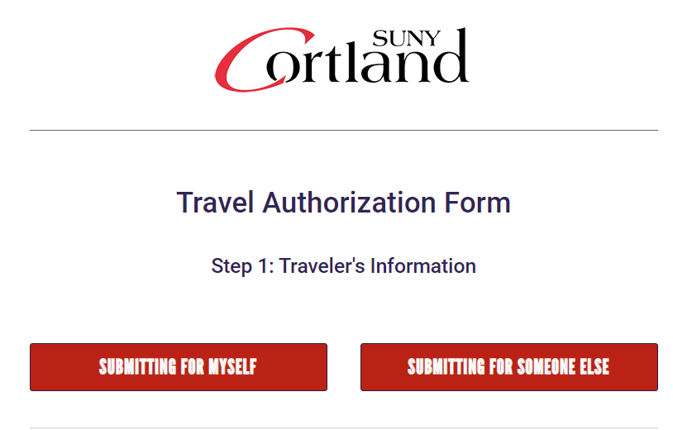
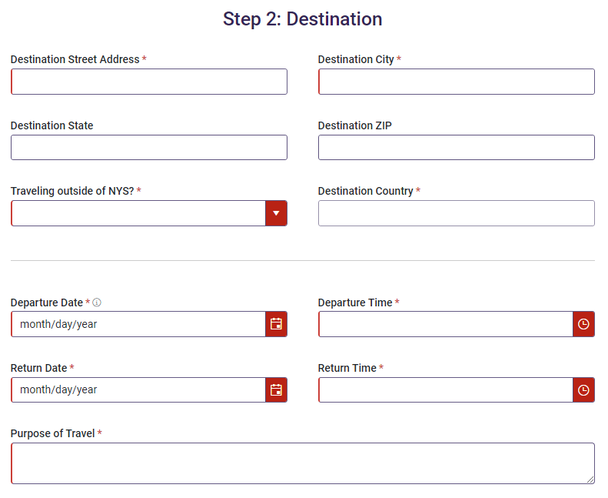
Travel Authorization
Travel Authorization Request Form – Electronic form
Campus authorization to travel is required for official State business, whether or not cost reimbursement will occur.
  This protects the employee in the event of an incident.
  A fully executed Travel Authorization Form must be received by the Business Office BEFORE travel occurs.
    Signed by traveler, supervisor, Dean’s AA/VP, and Provost (if out of state/country for Academic Affairs)

Slide 4
Car Rentals
https://www2.cortland.edu/offices/purchasing-office/travel-guidelines/#car-rentals
OSC Travel Manual, "If available, State vehicles should always be considered when the use of an automobile is required.“
Hierarchy of Vehicle Usage Flowchart
Request a Fleet Vehicle (if your Official Station is SUNY Cortland)
If a fleet vehicle is unavailable and a fleet waiver has been received OR traveler’s Official Station is not SUNY Cortland, traveler must use the OGS Trip Calculator to determine whether a personal or rental vehicle is the most economical means of ground transportation to use (reimbursement will not exceed the OGS Trip Calculator).
A compact size vehicle should be used.
    Any other vehicle type requires approved justification.
No additional insurance should be purchased when renting vehicles.
Unauthorized persons should not be allowed to drive the vehicle.
Always rent in the name of State of New York.

Slide 5
Conference Registration Fees
https://www2.cortland.edu/offices/purchasing-office/travel-guidelines/#conference-registration-fees
Conference registration fees are to be paid directly by the department p-card holder.
  If a credit card is not accepted, a PO should be submitted ASAP in RDD.

Slide 6
Day Trip Meal Reimbursement
https://www2.cortland.edu/offices/purchasing-office/travel-guidelines/#day-trip-meal-reimbursement
Trips one day or less, but more than 35 miles from Official Station.
Determined by departure & return times
  Leave at or before 7:00 AM – eligible for Breakfast
  Return at or after 7:00 PM – eligible for Dinner
    Breakfast = $5.00
    Dinner = $12.00
    (Lunch is never reimbursed)
  Day trip meal reimbursements are reportable as income to the IRS and are subject to withholding taxes.
  Rates subject to change.

Slide 7
Hotel Reservations
https://www2.cortland.edu/offices/purchasing-office/travel-guidelines/#hotel-reservations
Reservations are made by either the traveler or the dept/office Administrative Assistant.
Request “State/Government Rate”
  If hotel in NYS, advise that we are Sales Tax Exempt, and a Tax Exemption Certificate should be provided.
Check lodging per diem rates
  If the hotel costs more than the per diem rate allowed for that location, an Over-the-Max Request must be submitted prior to booking hotel.
Obtain itemized receipt upon checkout.

Slide 8
Over-the-Max Lodging Request
https://www2.cortland.edu/offices/purchasing-office/travel-guidelines/#over-the-max-lodging-requests
Approval must be obtained prior to booking the hotel room.
  Failure to do so may result in limited or denial of reimbursement.
Electronic form – requestor will receive a final approved version – that is your “OK” to book.

Slide 9
Personal Car Mileage
https://www2.cortland.edu/offices/purchasing-office/travel-guidelines/#personal-car-mileage
Per OSC Travel Manual, "If available, State vehicles should always be considered when the use of an automobile is required.“
Hierarchy of Vehicle Usage Flowchart
Request a Fleet Vehicle (if your Official Station is SUNY Cortland)
If opting to use a personally owned vehicle (and your *Official Station is SUNY Cortland), when a fleet vehicle is available (or failed to request a fleet vehicle), reimbursement will be at the current rate of $0.21/mile regardless of total miles traveled.
If opting to use a personally owned vehicle (and your *Official Station is SUNY Cortland), when a fleet vehicle is unavailable (have fleet waiver), traveler must complete the OGS Trip Calculator regardless of total miles traveled and reimbursement will be the lessor of rental vs. mileage.
      The fleet vehicle waiver must be attached to your travel paperwork.
If opting to use a personally owned vehicle (and your *Official Station is not SUNY Cortland), the traveler must complete the OGS Trip Calculator regardless of total miles traveled and reimbursement will be the lessor of rental vs. mileage.
*Official Station, as defined by SUNY Cortland:
If you work at the Cortland campus and/or have a workstation designated on campus, then your Official Station is SUNY Cortland.
If you do not work at the Cortland campus at all, then your Official Station would not be the Cortland campus.

Slide 10
Travel Advances
https://www2.cortland.edu/offices/purchasing-office/travel-guidelines/#travel-advances
To cover per diem costs of meals, lodging, and/or airfare
Must be indicated on Travel Authorization
Should not be less than $75 or exceed funding limitations
Issued 2 weeks prior to travel date (4 weeks for airfare)

Slide 11
Per Diem Rates
https://www2.cortland.edu/offices/purchasing-office/travel-guidelines/#travel-per-diem-rates
Search rates within the continental US
Lodging & meal allowances are calculated based on location
Lodging
Use month of stay
Meals
Use M&IE Total column amount
  SUNY Cortland uses an 80/20 breakdown for dinner & breakfast
    Example:
      $74 M&IE Total
        Breakfast = $15.00 (20%)
        Dinner = $59.00 (80%)
        Breakfast on day 1 only if traveler leaves at/before 7:00 AM
        Dinner on last day only if traveler returns at/after 7:00 PM

Slide 12
Travel Reimbursement
https://www2.cortland.edu/offices/purchasing-office/travel-guidelines/#travel-reimbursement
Travel Voucher (AC132)
Per NYS, within 30 days of returning from their trip, the traveler must submit a travel voucher packet, containing the voucher and any supporting documentation.
Upon return from trip
  Complete Travel Voucher (AC132) (whether requesting reimbursement or not ($0.00))
    Attach all receipts (lodging, tolls, parking, registration fees, etc.) (not meal receipts if using unreceipted method)
    If conference, include conference agenda
    For mileage or rental car gasoline reimbursement, complete the Statement of Automobile Travel (Form AC 160)
    Traveler signs voucher
    Traveler’s supervisor signs voucher
    Add Account # (bottom left)

Slide 13
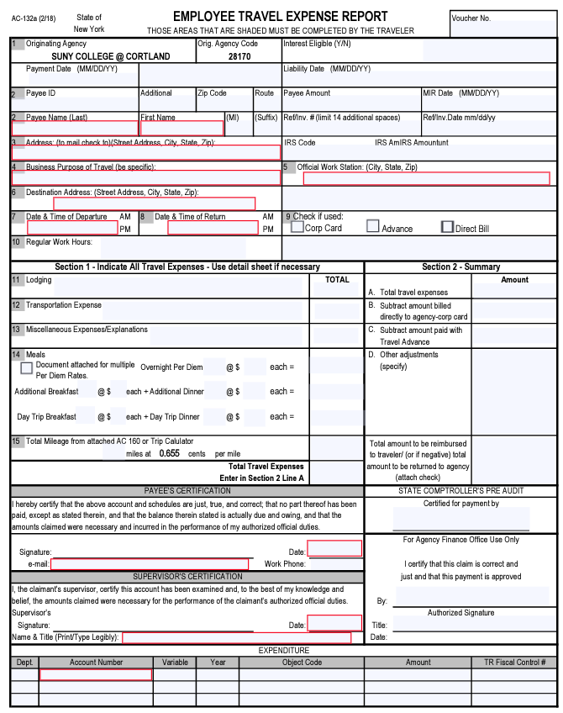
Tips
Top Portion of Travel Voucher
Do not add employee ID # or SSN to voucher.
Include traveler’s home address (not SUNY Cortland)
This is to ensure the reimbursement goes to the correct person.
Business Purpose = Name of Conference, Meeting, etc. (not “Travel”)
Include full address of destination (Street, City, State, Zip)
Dates and times of departure and return
Section 1
Complete all applicable fields with descriptions & amounts
Any missing receipt, please include a missing receipt affidavit
Section 2
Total from left side
Total paid with p-card
Travel Advance Amt
Other adjustments
Grand Total of Reimbursement
Payee Certification
Traveler and their Supervisor both need to sign and date
Don’t forget an account number to charge
Reimbursements will be sent back if not fully completed.
Email: travel@cortland.edu

